Slide 1
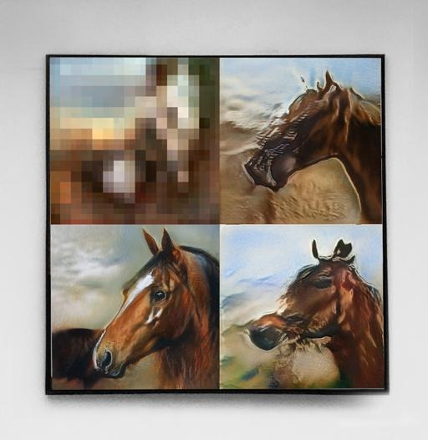
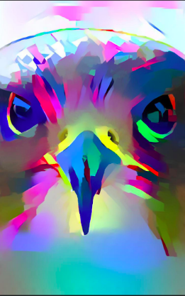
Methodology of AI Falcon
Apr. 19, 2022

Slide 2
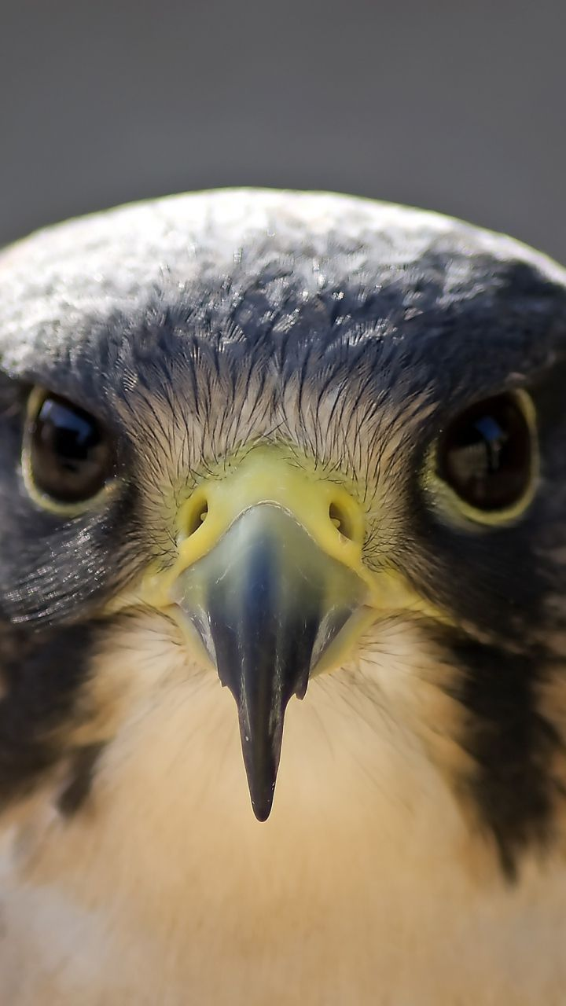
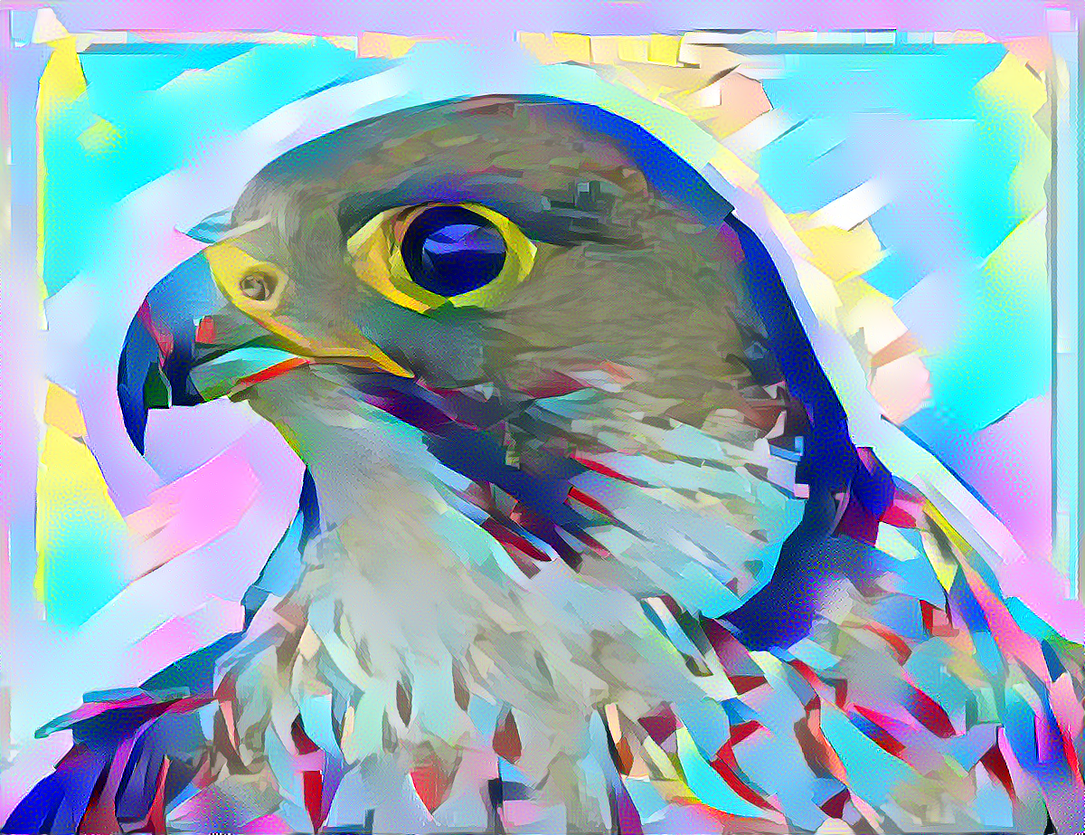
Input & Output
Content image
Resolution: 720 x 1280
Style image
Resolution: 1200 x 923
Result image
Resolution: 6016 x 9600

Slide 3
Description
Neural style transfer (Style Transfer) is an algorithm that manipulate digital images, or videos, in order to adopt the appearance or visual style of another image or even artwork image. Different style transfer algorithms are characterized by their use of deep neural networks for the sake of image transformation. In this exhibition, the use of style transfer is the creation of artificial intelligent (AI) artworks from photographs, for example by transferring the appearance of artist paintings to artist-selected photographs.

Slide 4
Description
This method has been also used by other artists and designers recently around the globe to develop new artwork based on existent style(s). What novel by Dr. James She in these AI artworks are the newly identified pop art style and the archived fine-grained visual quality.
These are realized by integrating the Style Transfer with a series of new computation processes that can differentiate the levels and positions of styles from Dr. James She ‘s artwork being transferred to a selected falconry photograph subject to the semantic meanings of objects and the importances of their certain visual features in the photograph.

Slide 5
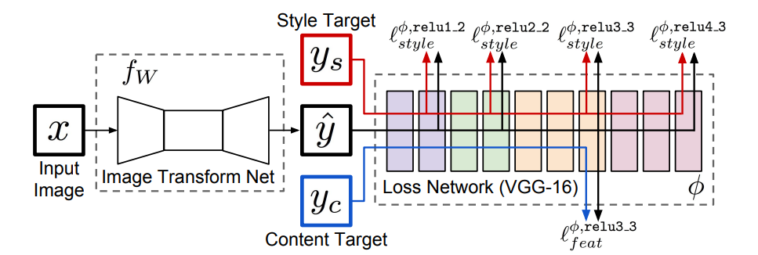
Flow chart
Style image
2.1 Apply neural style transfer[1] to the image
Content image preprocessing
Result post-processing
1.1 Change to white background
3. Scale up the image to 2k
Content image
1.2 (Optional) Cropping
2.3 (Optional) Combine multiple stylized images
4. Apply noise removal
1.3 (Optional) Change a good background
1.4 (Optional) Cut a specific part
2.2 (Optional) Apply style transfer to part of the image
5. Scale up the image to 8k
Style image
Result image
[1] Image Style Transfer Using Convolutional Neural Networks https://www.cv-foundation.org/openaccess/content_cvpr_2016/html/Gatys_Image_Style_Transfer_CVPR_2016_paper.html

Slide 6
Network architecture (Artwork & Video)
Artwork (https://arxiv.org/abs/1508.06576)
VGG network, a convolution neural network
Flexible to different styles, content weights and style weights
Video (https://arxiv.org/abs/1603.08155)
Faster process time
Better quality in super-resolution

Slide 7
Example 1
Content weight, α
Content image
Style weight, β
Result image
Style image

Slide 8
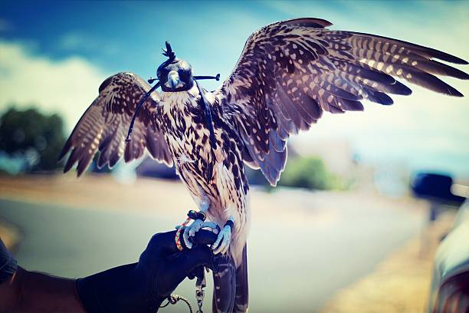
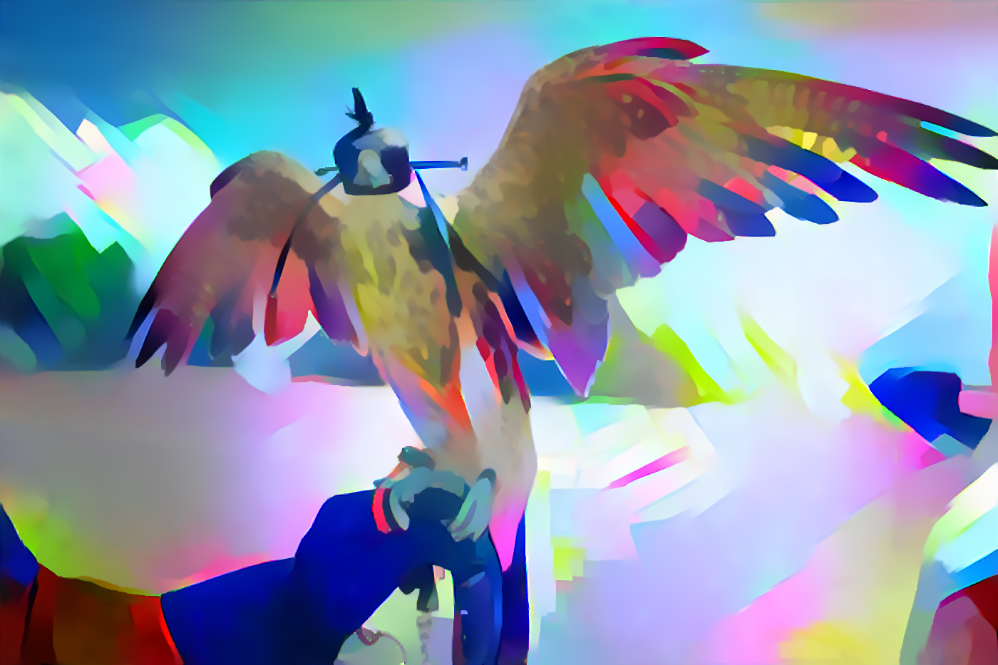
Example 2
Content weight, α
Content image
Style weight, β
Result image
Style image

Slide 9
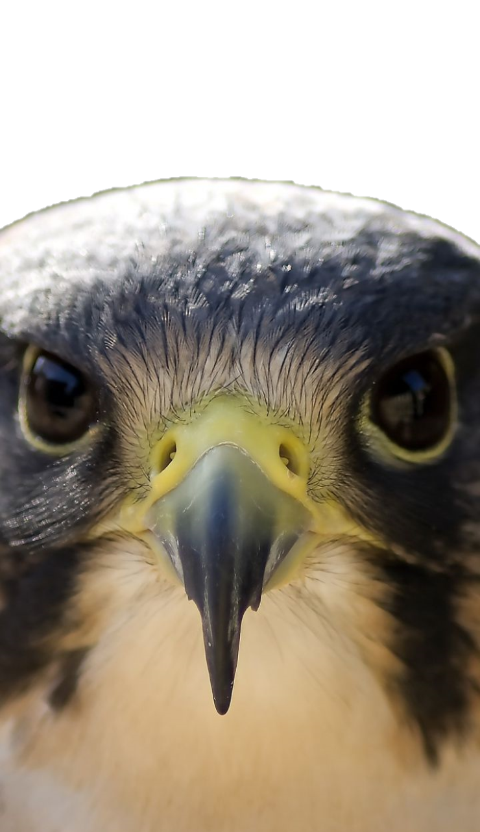
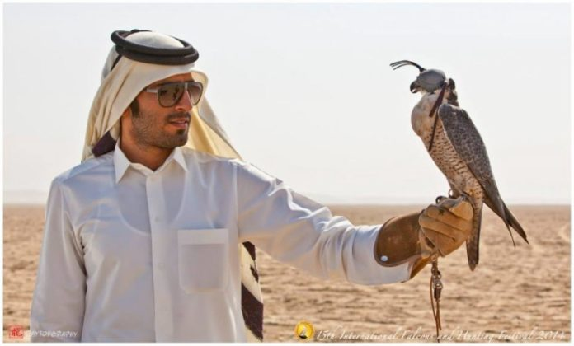
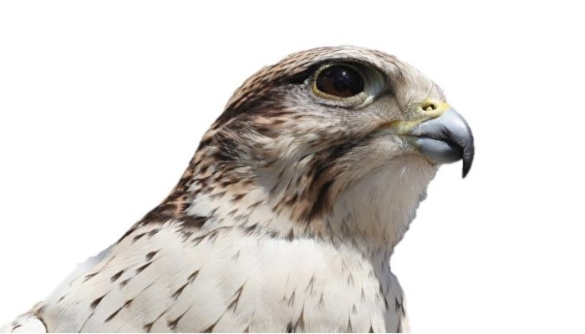


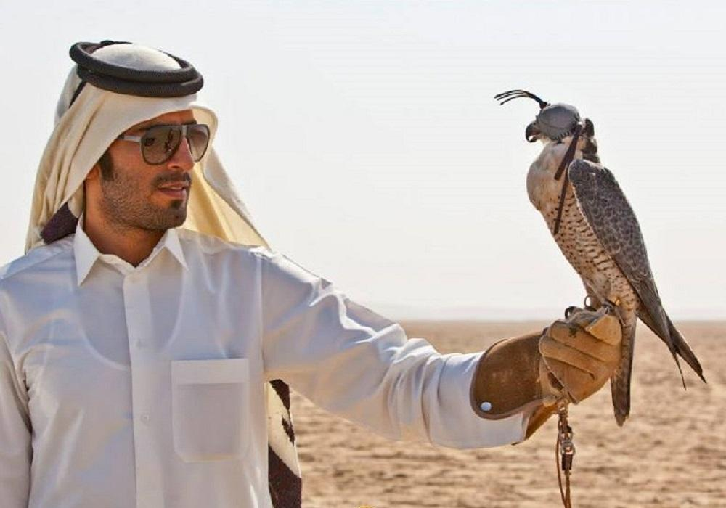
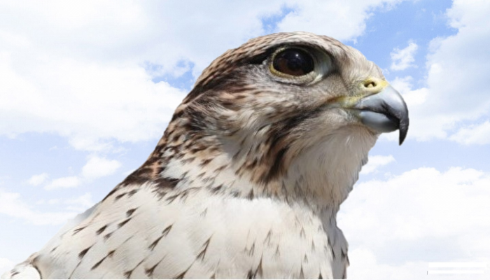
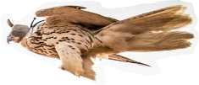
Content Image Preprocessing
+
1.1 Change to white background
1.2 (Optional) Cropping
1.3 (Optional) Change to a good background
1.4 (Optional) Cut a specific part

Slide 10
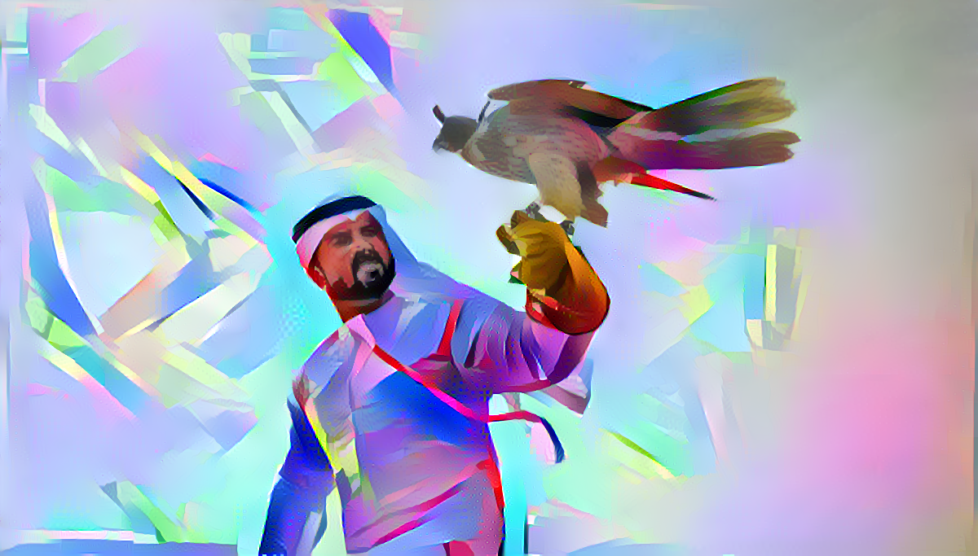
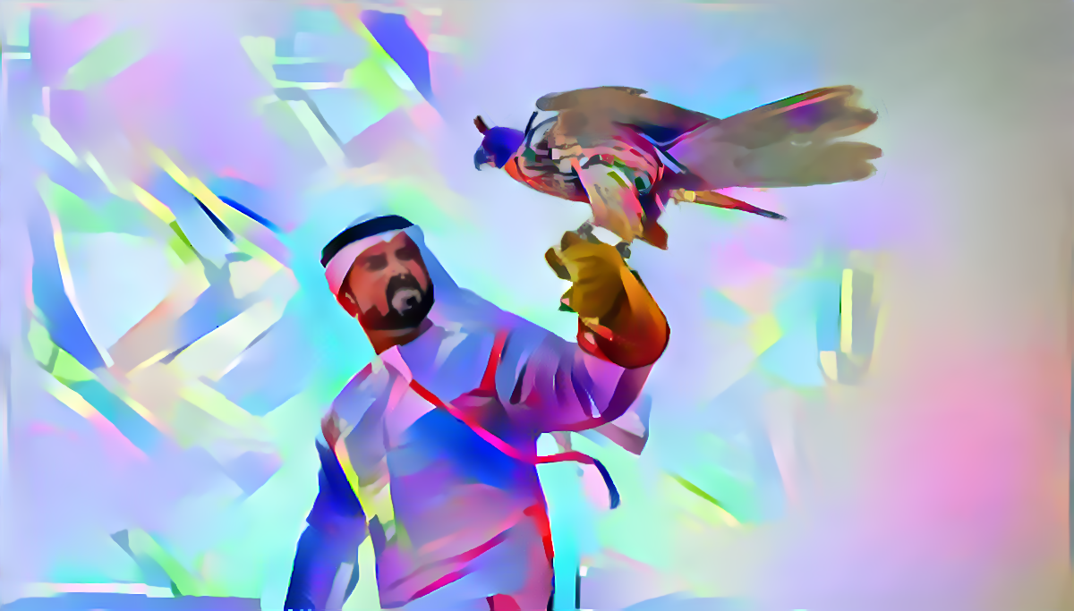
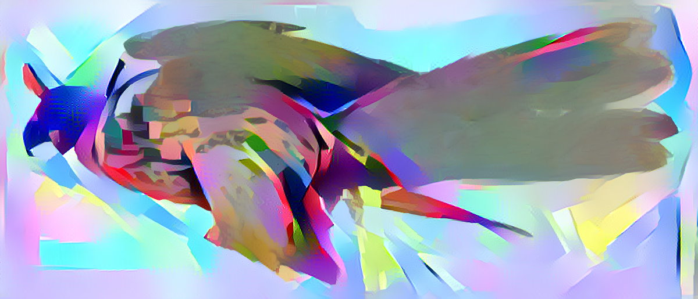
Style Transfer
2.1 Apply style transfer to the whole image
Content weight: 3000
Style weight: 0.01
Variation weight: 10
Epoch: 20
2.2 (Optional) Apply style transfer to part of the image
Content weight: 1000
Style weight: 0.009
Variation weight: 10
Epoch: 20
2.3 (Optional) Combine multiple stylized images

Slide 11
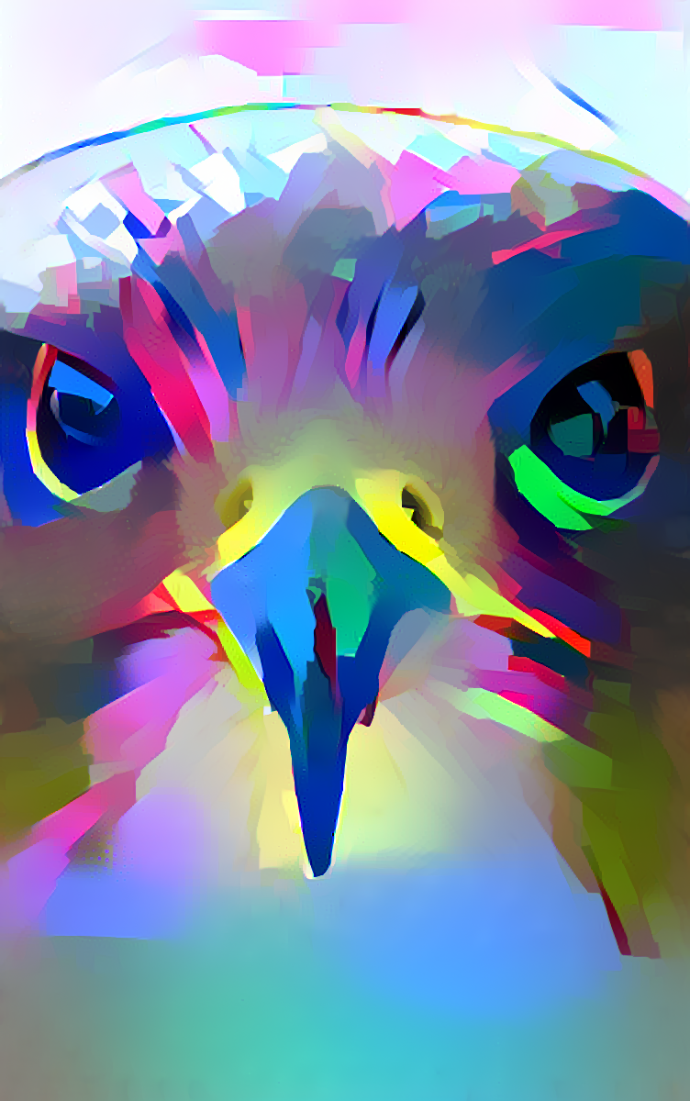


Result Post-processing
3. Scale the image up to 2k
Resolution: 1504 x 2400
4. Apply noise removal
5. Scale the image up to 8k
Resolution: 6016 x 9600

Slide 12
Recommended videos about style transfer
Explained - Neural Style Transfer Research Paper (Network)
https://www.youtube.com/watch?v=0tTRA3emrr4
Neural Style Transfer Revisited - Machine Learning Art
https://www.youtube.com/watch?v=Xjl1M0Fpmdo
Basic Theory | Neural Style Transfer #2 (Introduction to Neural Style Transfer)
https://www.youtube.com/watch?v=B22nIUhXo4E

Slide 13
The End

Slide 14
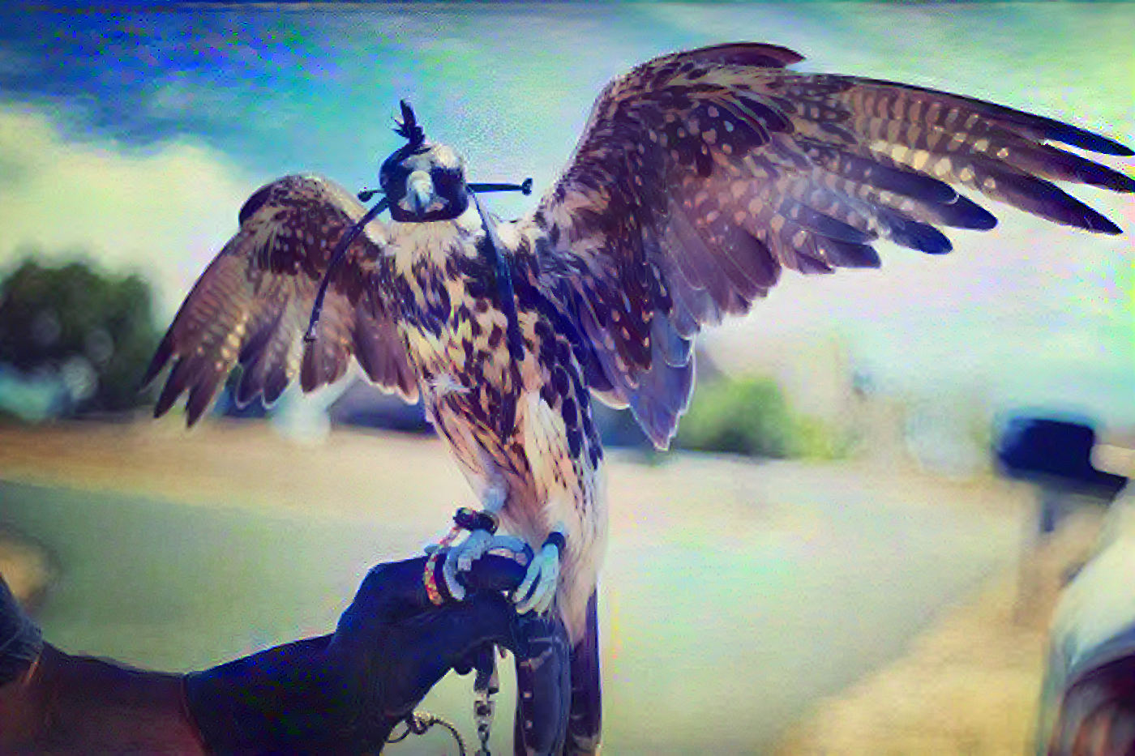
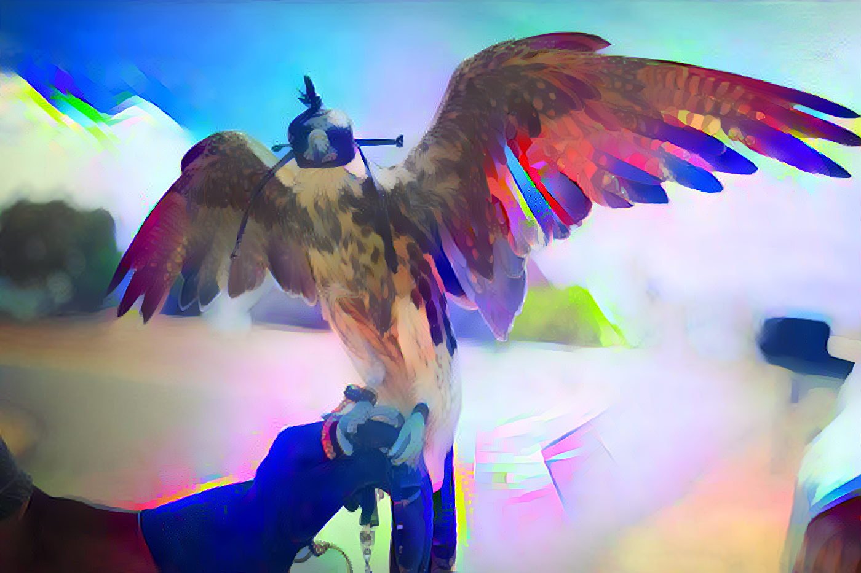
Appendix - 1
Content Image
Content Weight: 125000
Style Weight: 0.00008
Content Weight: 5000
Style Weight: 0.002
Content Weight: 1000
Style Weight: 0.01
Content Image
Style Image

Slide 15
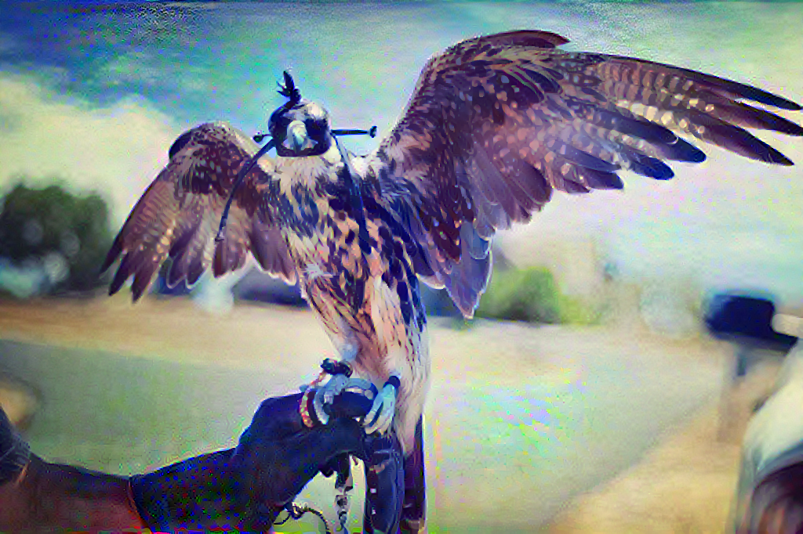
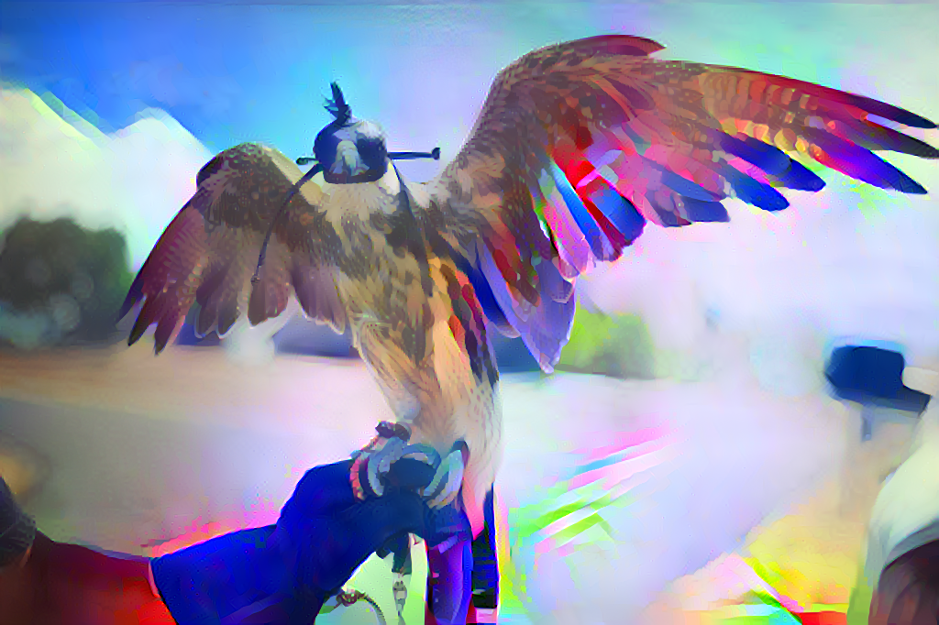
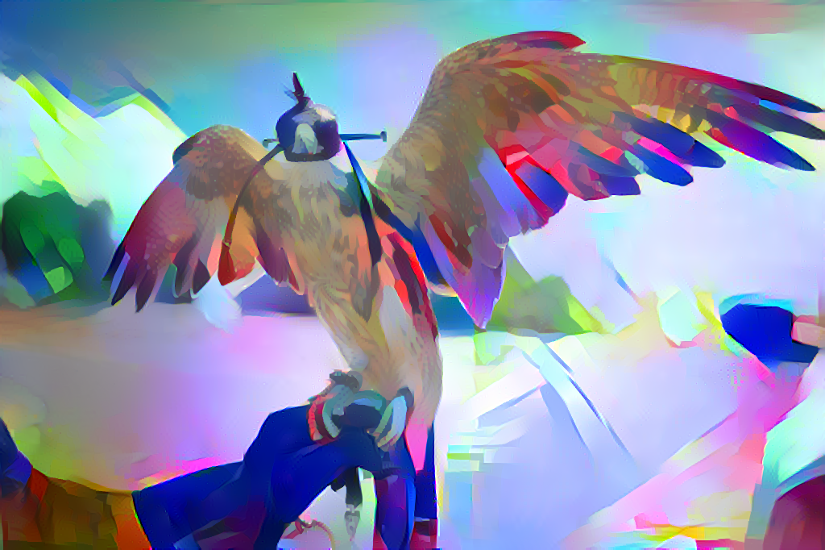
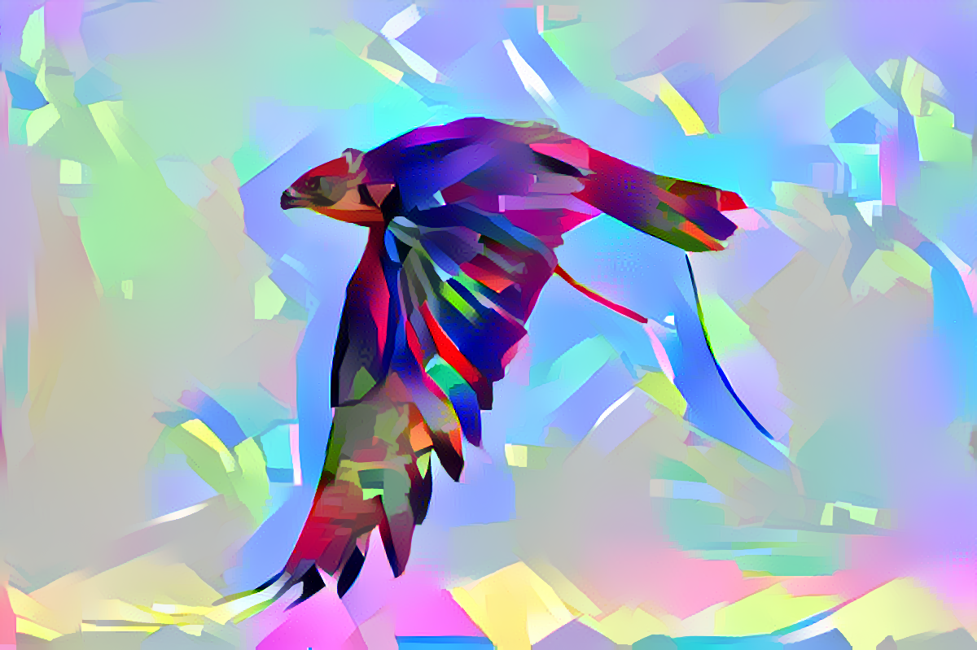
Appendix - 2
Content Image
Content Weight: 125000
Style Weight: 0.00008
Content Weight: 5000
Style Weight: 0.002
Content Weight: 1000
Style Weight: 0.01
Content Image
Style Image

Slide 16
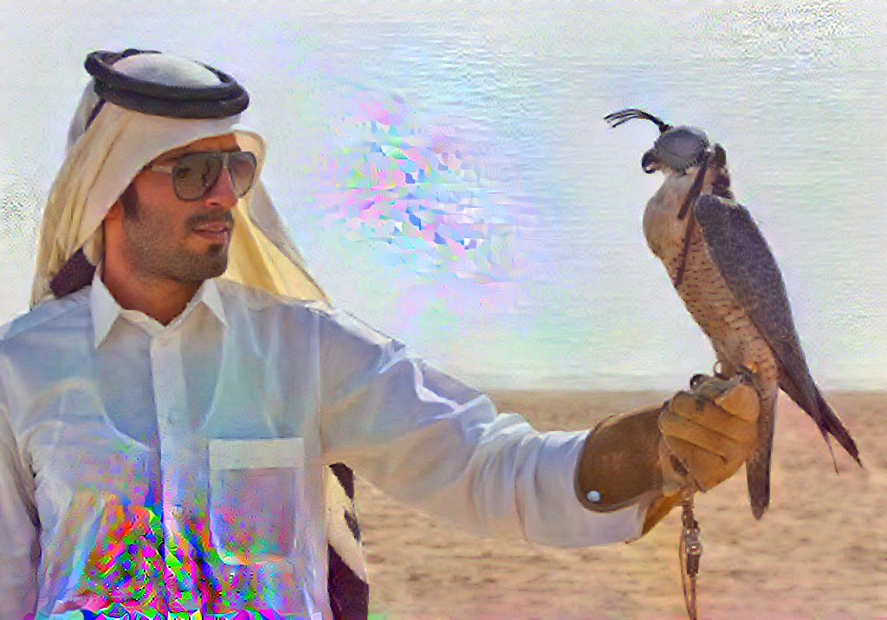
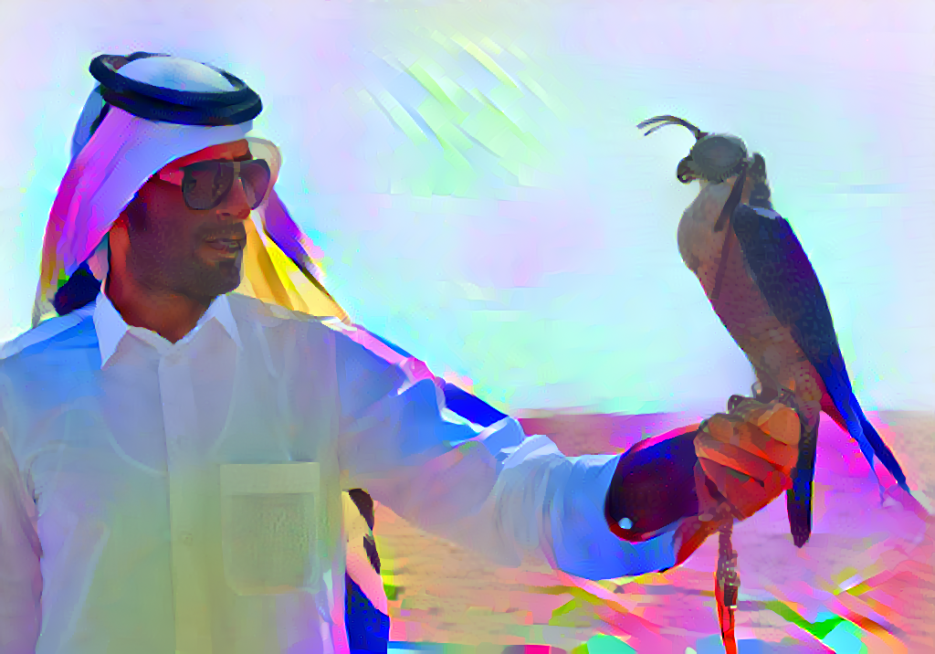
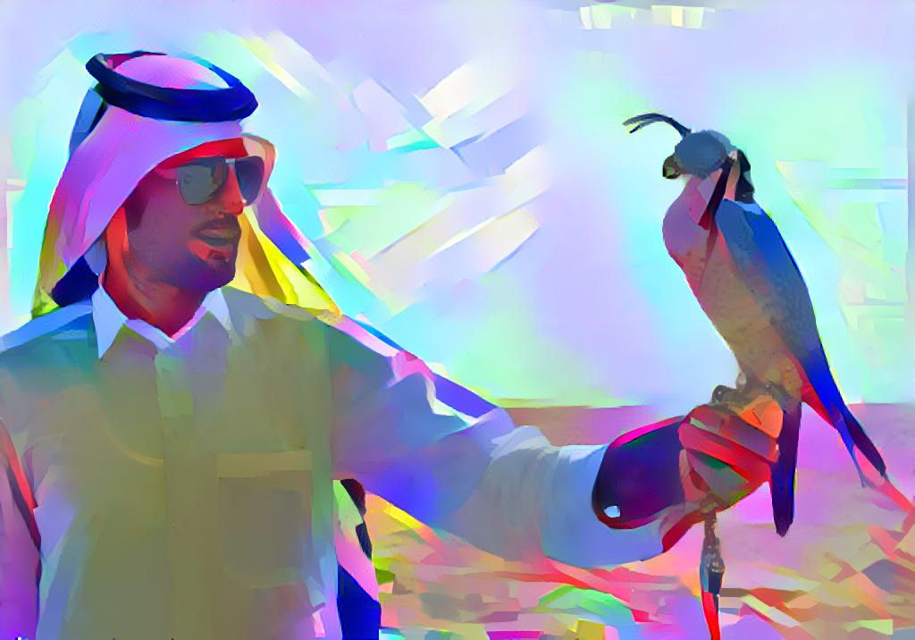
Appendix - 3
Content Image
Content Weight: 62500
Style Weight: 0.00008
Content Weight: 2500
Style Weight: 0.0012
Content Weight: 500
Style Weight: 0.006
Content Image
Style Image

Slide 17
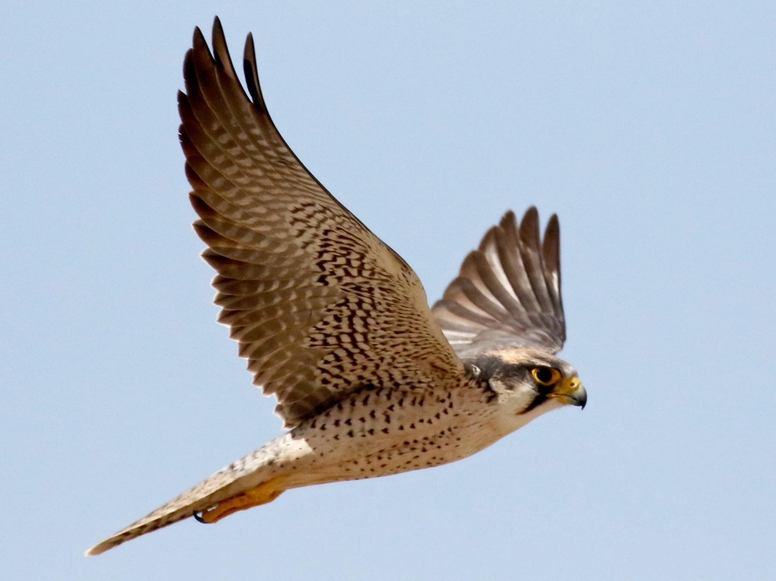
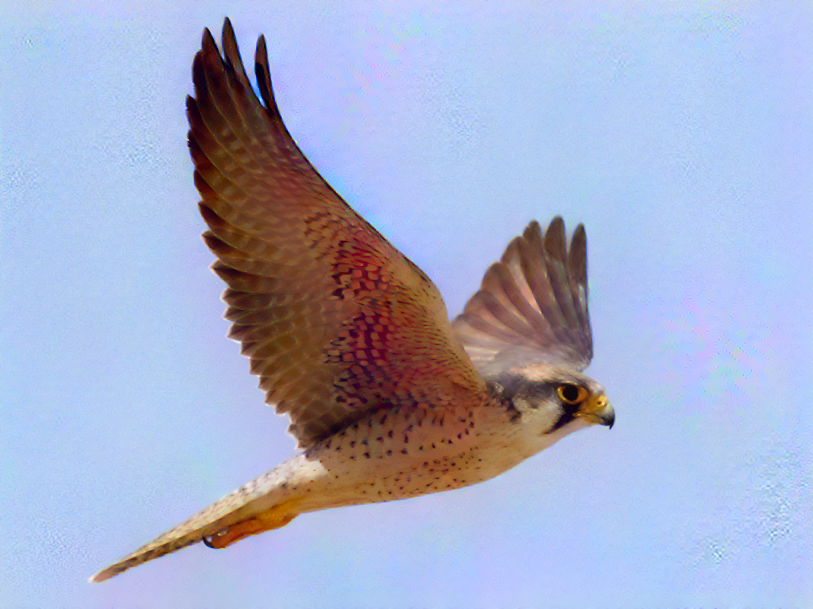
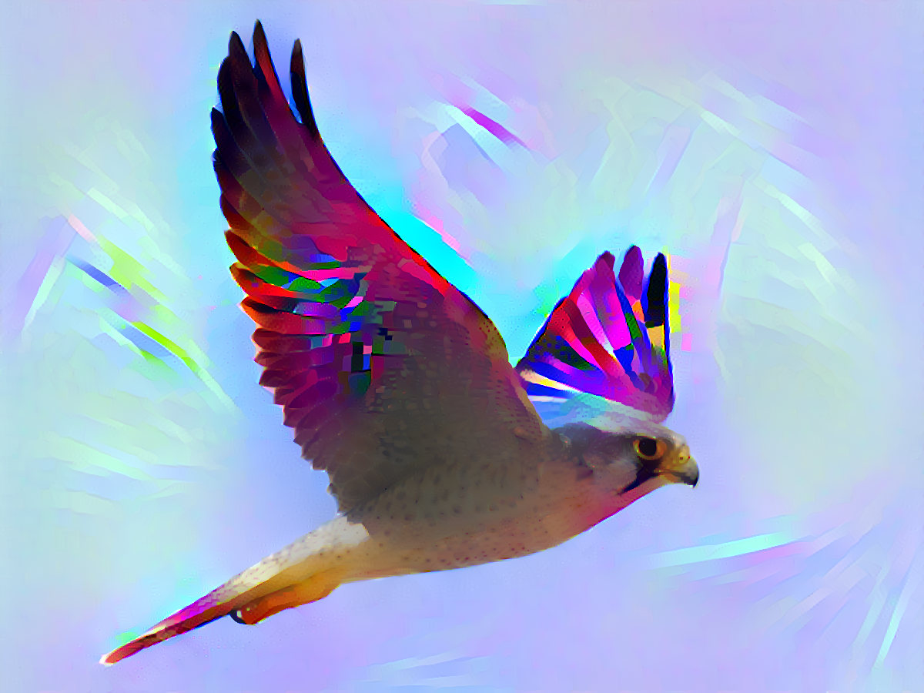
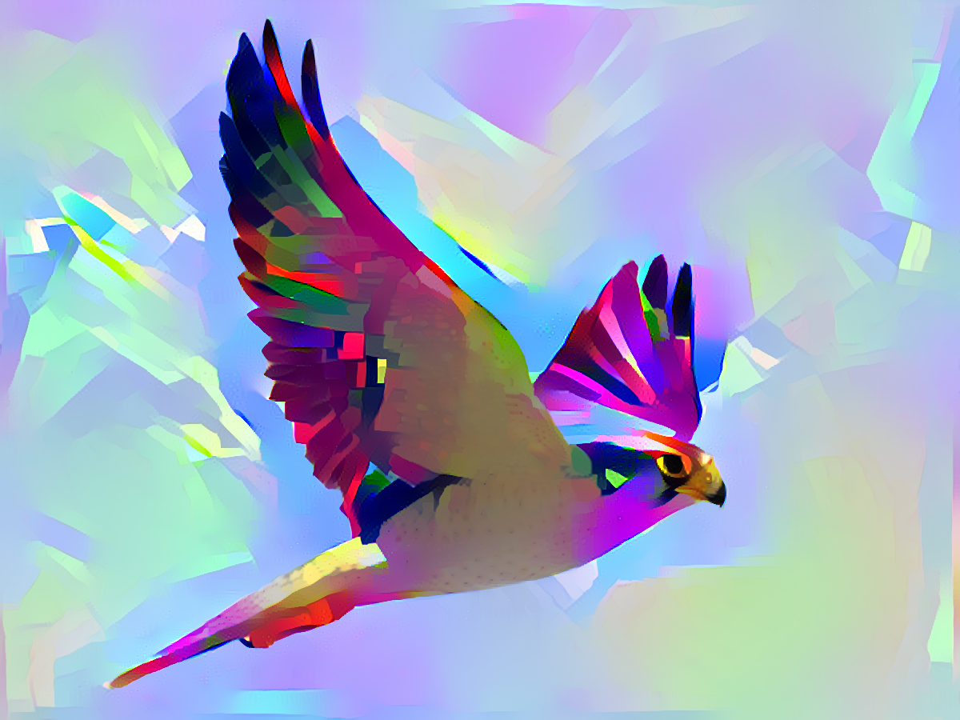
Appendix - 4
Content Image
Content Weight: 37500
Style Weight: 0.000024
Content Weight: 1500
Style Weight: 0.0006
Content Weight: 500
Style Weight: 0.003
Content Image
Style Image

Slide 18
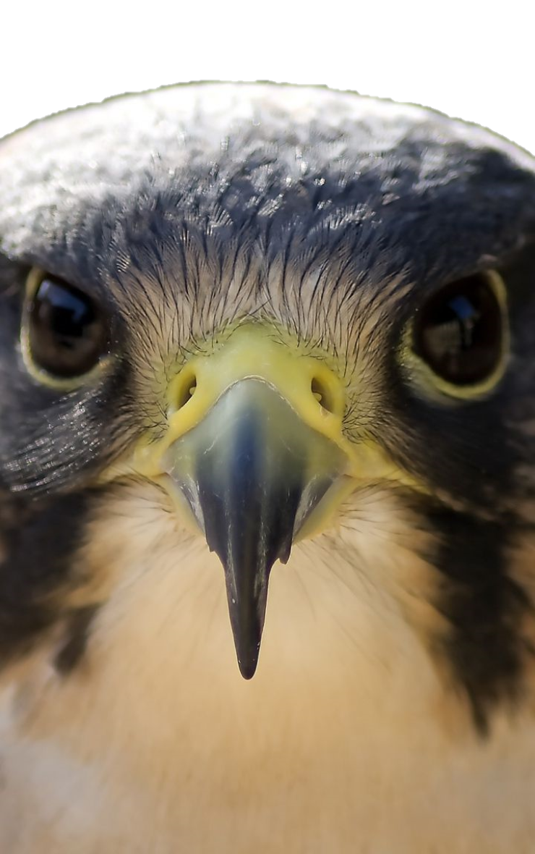
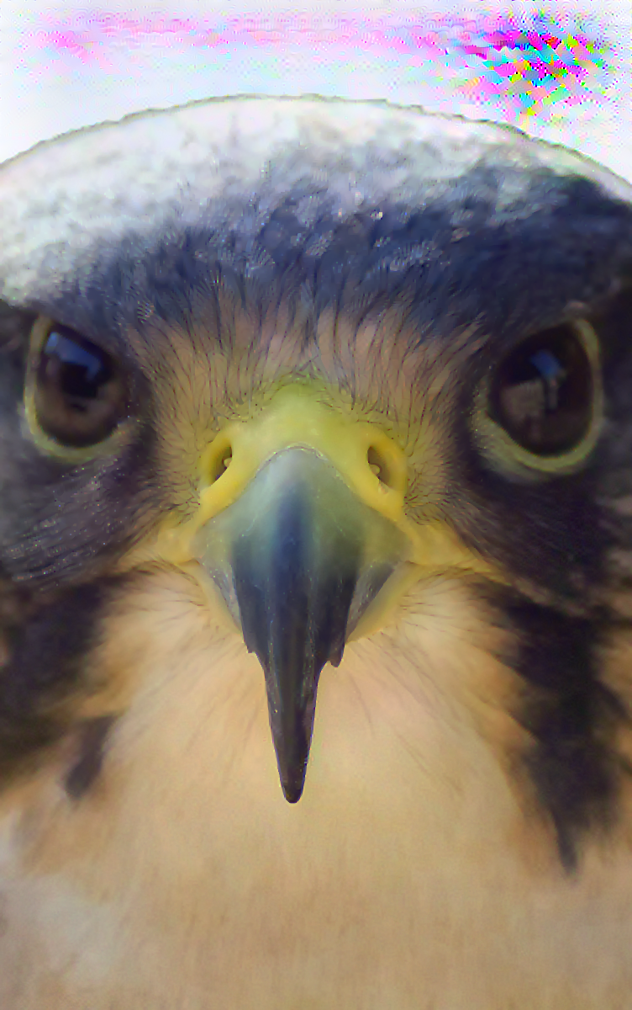
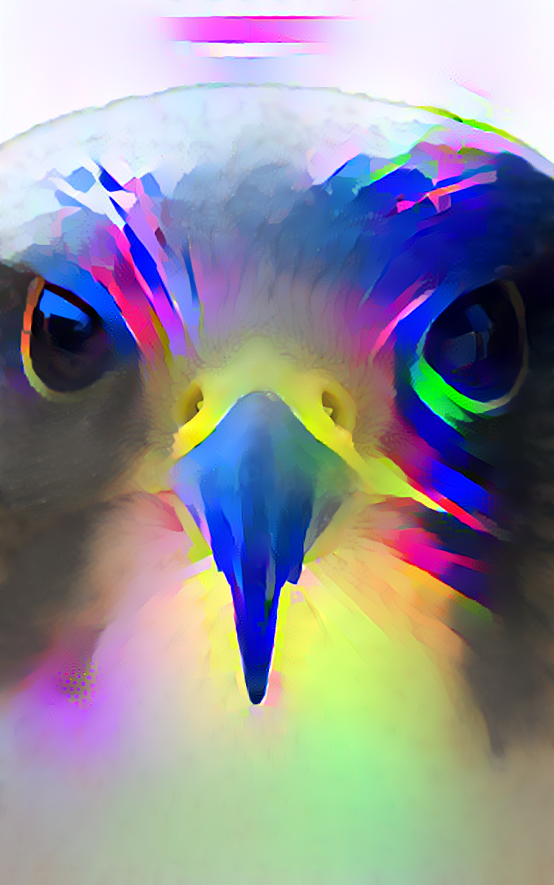
Appendix - 5
Content Image
Content Image
Content Weight: 37500
Style Weight: 0.0004
Content Weight: 1500
Style Weight: 0.0006
Content Weight: 300
Style Weight: 0.003
Style Image

